Slide 1
ENSE 374, Milestone 1
The Great Value
Azeezat, Krupal, Joseph, Clark, Martha
September 27, 2018

Slide 2
Problem Definition
WHO/CLIENT
Engineering Department
WHAT
The current website is hard to navigate.
WHERE
Engineering faculty website
Notes:
The current website is very hard to navigate. It is hard to find folders and access intranet in order to access and get information in and out. It is hard to access anywhere in the world. The naming of some folders are similar, which makes it difficult for people to find some folders and it ends up being multiple folders of similar names.

Slide 3
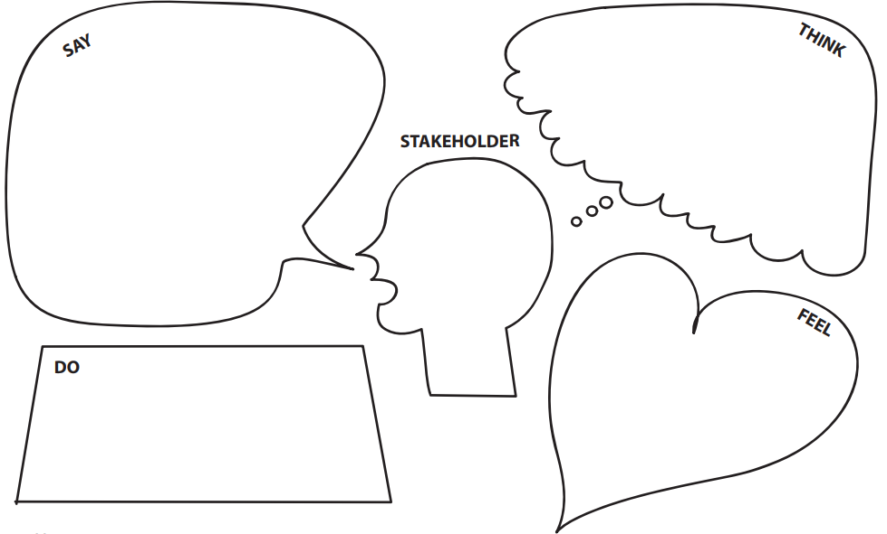
They want efficiency. They need a place to share information securely and coming to us will help them.
Easy to navigate website
Simplicity
Edit content
Better organization of different files and folders
Accessibility based on security needs and priority.
Frustrated:
It’s so hard to be efficient when everyone has issues finding what they’re looking for.
Not everyone has access to the same files so they end up creating new ones, which causes problems
They came forward with ideas of what they wanted and spoke to us in order to get their ideas heard.
Notes:
The Engineering Department needs a way to organize their files on the website because they are spending time and feeling frustated looking for needed files.
Empathy Maps
Say - They need an easy to navigate website, simplicity, able to edit content, accessibility for different faculty members, organizing different files and folders, easier access, naming of folders are similar (so they want the website to be intuitive, able to find things that go together), accessibility based on security needs and priority.
Think - They said what they were thinking. They wanted a solution for their problems. They want efficiency. They need a place to share information and coming to us will help them. maybe...
Do - They came forward with ideas of what they wanted and spoke to us in order to get their ideas heard. They want us to do what they want.
Feel - They feel frustrated because it’s so hard to be efficient when everyone has issues finding what they’re looking for. Not everyone is experienced in tech. Not everyone has access to the same files so they end up creating new ones, which cause problems and makes it necessary to create new, similar files which makes it not unified.

Slide 4
Our Team:
Meeting Dates | Meeting Minutes
09/21/2018 | In our first meeting, we talked about techniques we're going to use to complete this project. Furthermore, we set up a PowerPoint that we will use to present our ideas in the class.
09/25/2018 | Started the first draft of the presentation.
09/26/2018 | Prepare the presentation and set all the aspects of the project clear. Practice the presentation and make sure it meets the time limit.

Slide 5
Introduction
The goal of this project is to improve the efficiency of the Engineering Department by making a better website. They communicated that it is hard to find folders and access intranet in order to access and get information in and out. The naming of some folders are similar, which makes it difficult for people to find some folders and it ends up being multiple folders of similar names. This document explains the planning phase of the project and the goals we plan to achieve and will also serve as a logbook. In order to complete this project, we organize meetings, discuss ideas and document them to keep track of our progress.

Slide 6
User Requirements
Name | Definition
R1- Upload/edit files | Upload documents without generating duplicates, and without needing help from technical support.
R2 - Intuitive | Intuitive flow on the web page
R3 - Secure access | Accessibility based on the level of the user, following the Federal Privacy Act.
R4 - Simplicity and efficiency | Each user requires easy access to their files
Notes:
Functional Requirements
Files:upload, delete, edit
Readable
Give access to the user depending on the profile
The user have to log in

Slide 7
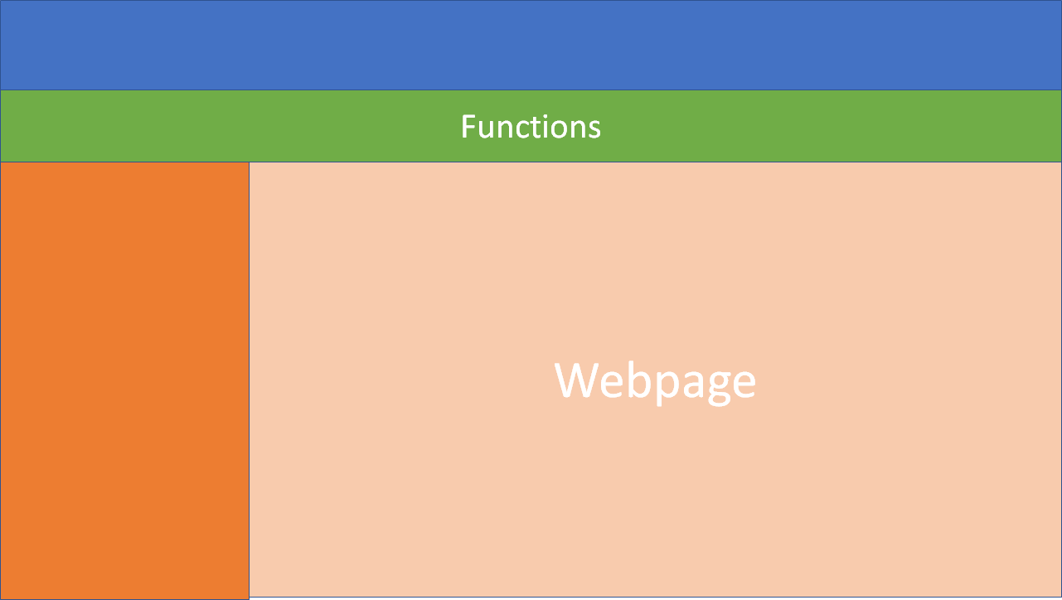
Files
Notes:
Interface: Hardware and Software

Slide 8
Security and Privacy

Slide 9
Breach of Security | Consequence
Loss/ corruption of data | Time constraints Recovering corrupted data is costly
Disclosure of secrets and sensitive information: | Violations of user's privacy Bad reputation for the organization Threats
Disclosure of privileged/privacy information about individuals: | Private information may be used in bad activities like fraud
Corruption of software or introduction of malware, such as viruses | Slows or shut down the server Damage files Private data leaks
Notes:
Loss/ corruption of data: Lots of time and resources will be spent trying to recover and or create new files to make up for the lost ones. It will be costly to recover the files as there will be
Disclosure of secrets and sensitive information: Exposing sensitive information in the public would violate the privacy of the users. Also, the organization would have a bad reputation when this happened.
Disclosure of privileged/privacy information about individuals: Informations that was leaked would allow hackers to use it to ruin one’s reputation (e.g. work).
Corruption of software or introduction of malware, such as viruses: One of the worst consequences of a server that has been infected by a virus is that hackers could track user's private information discreetly.

Slide 10
Required Security | Why?
Physical security | Hard copies of information that could be retrieved by an outsider It is important to keep an eye out for intruders.
Access by user role or types | Accessed on a need to know basis To keep data secure
State access control requirements by data attribute | The administrators are the only one that need access to edit the information, if just anyone can edit then there’s no accountability
State access requirements based on system function | It reduces unnecessary information being shared from other group or organization This grants different accesses to different groups in order to keep privacy of information
Certification and accreditation of the security measures | It ensures that the user is knowledgeable enough to access files or documents.
Notes:
1. Physical security - this is required because there are hard copies of information that could be retrieved by an outsider to the organization. It is important to keep an eye out for intruders. 2. Access by user role or types - files and important information should only be accessed on a need to know basis, to keep data secure. 3. State access control requirements by data attribute - This is to ensure that information is not added 4. State access requirements based on system function - For example, if there is a need to grant access to certain system functions to one group of users, but not to another. For example, "The system shall make Function X available to the System Administrator only". 5. State if there is a need for certification and accreditation of the security measures adopted fo

Slide 11
In conclusion
The Engineering Department needs a secure, yet simple website with easy navigation. Different security access for different people is necessary and important and must follow the federal privacy act (FPA). Data privacy is important and confidential, medical, academic information should only be visible to staff on an absolute need to know basis.
Notes:
Add other insights if you like but remember, your group’s report-out must be kept within 10 minutes

Slide 12

Group Reflection
About this milestone:
We got established as a group. We liked the planning stage: set clear goals.
About ourselves:
We found that we are more efficient and get more work done when we are together.
In the future:
We will continue to listen equally to ideas of others as that is an important part of being in a group.
This builds unity in group settings!
Help needed?
We need help mostly with design and organization.
Image taken from: http://homeschoolcpa.com/board-turnover-may-mean-the-purpose-of-the-homeschool-group-could-change/
Notes:
How did you feel about this milestone? What did you like about it? What did you dislike?
This was a great and important milestone for us because we got established as a group and got to know each other, as we will be working together for 4 months. We liked the planning stage because it set clear goals for us to try to achieve.
What did you learn about yourselves as you collaborated and worked through this milestone?
We learned to get work done, we should all get together in the same place and we’re able to brainstorm and put our ideas together because what we all have to say is of equal importance.
How will you use what you have learned going forward?
We will listen equally to ideas of others as that is an important thing going forward. This builds unity in group settings.
What “stuff & things” related to this milestone would you want help with?
Design and organization

Slide 13
Questions?

